Slide 1
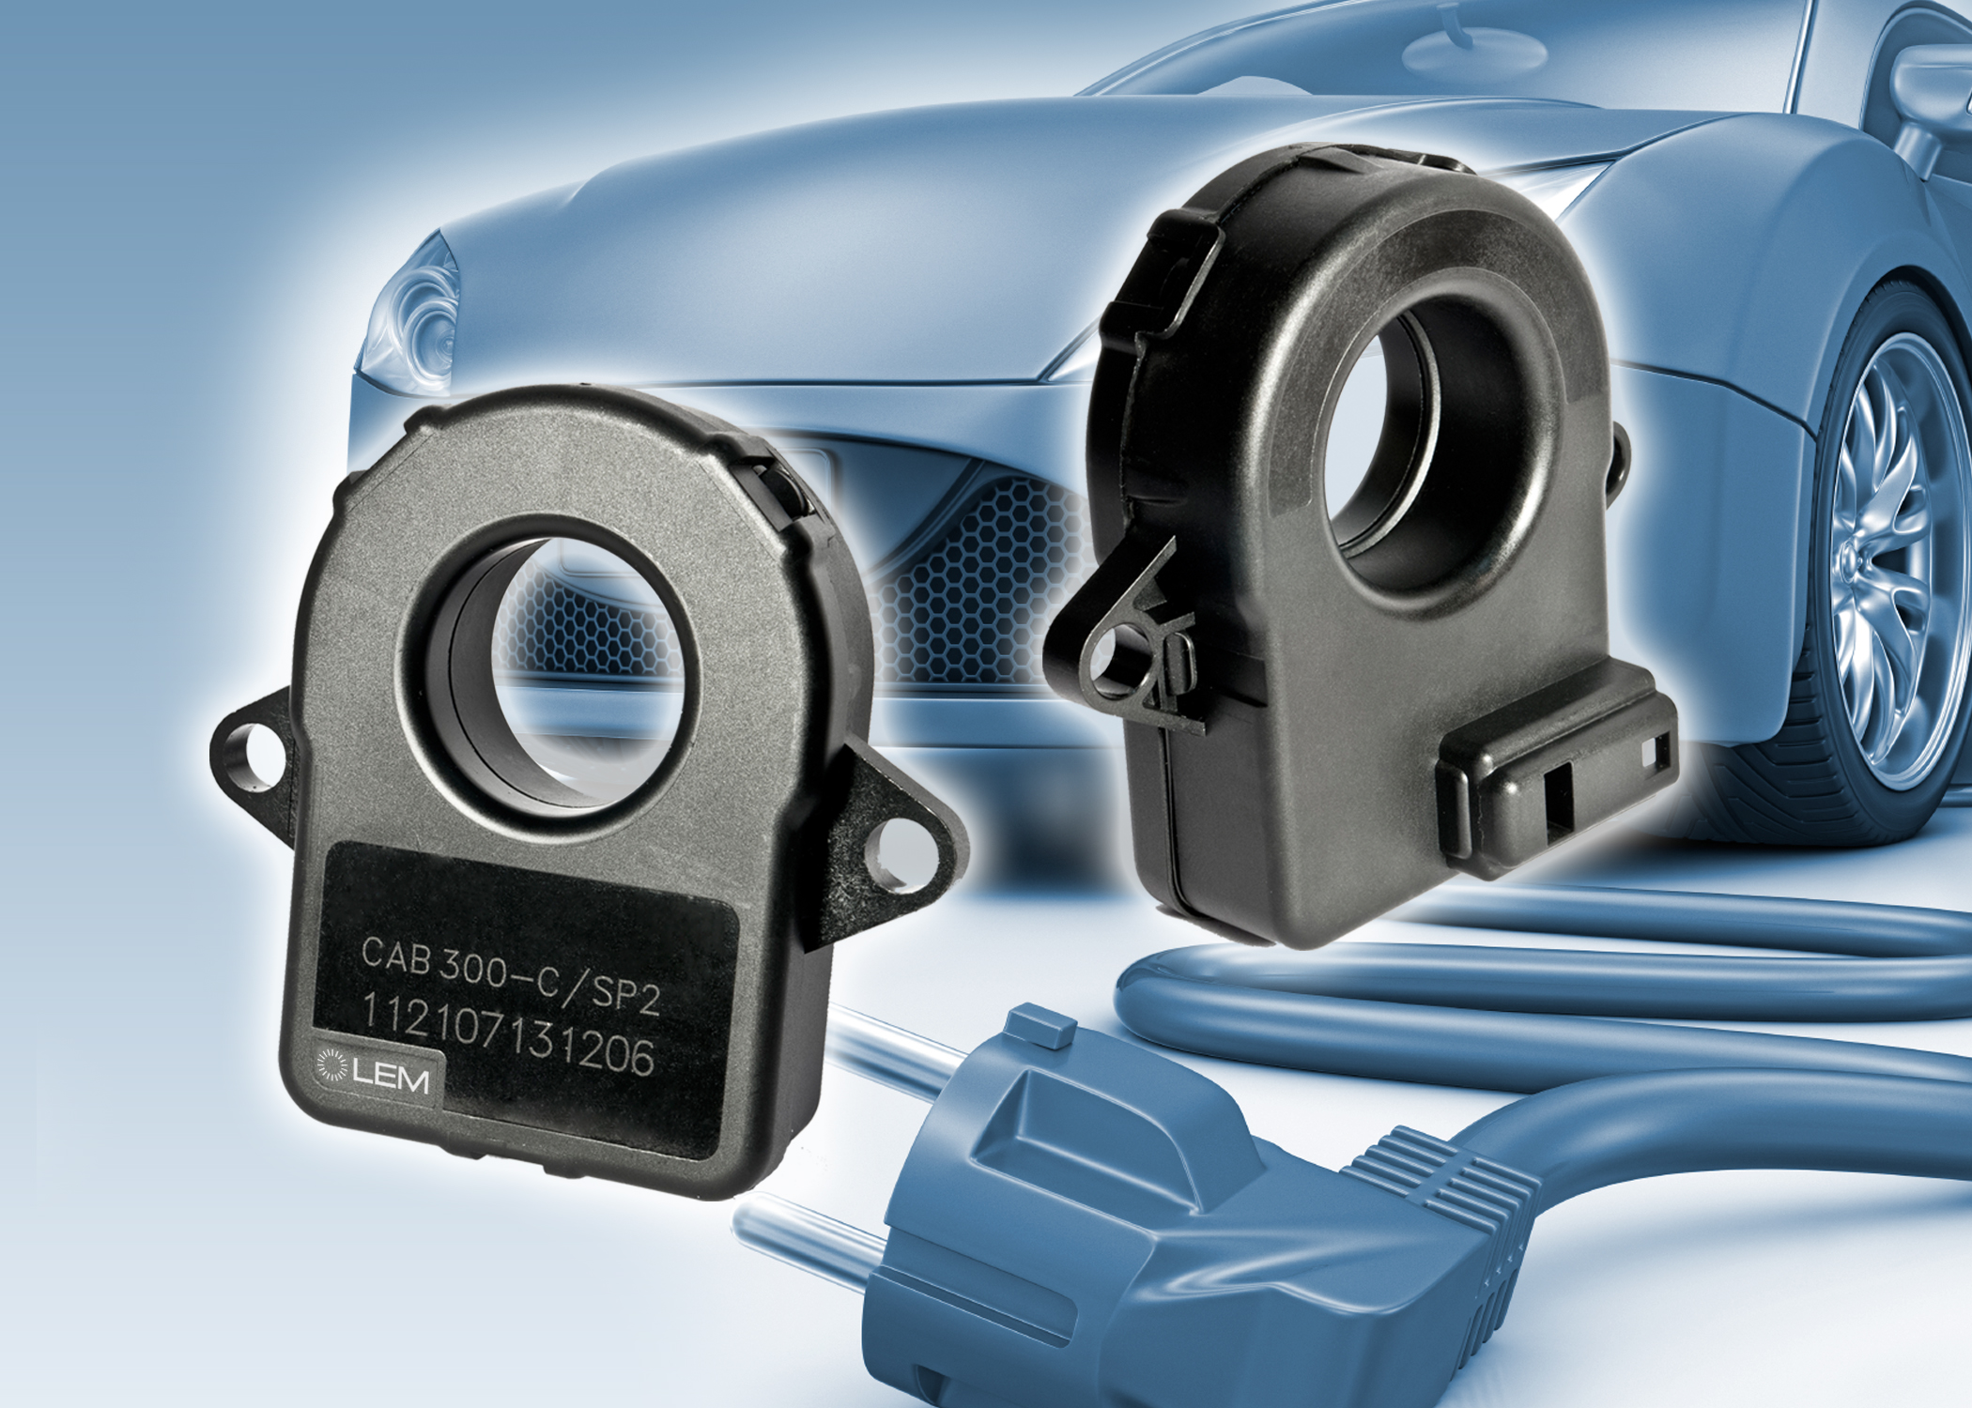

accurate SOC measurement for HEV and EV battery packs application
Gauthier Plagne

Slide 2
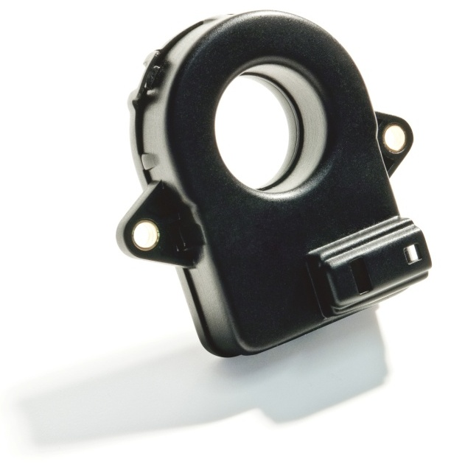
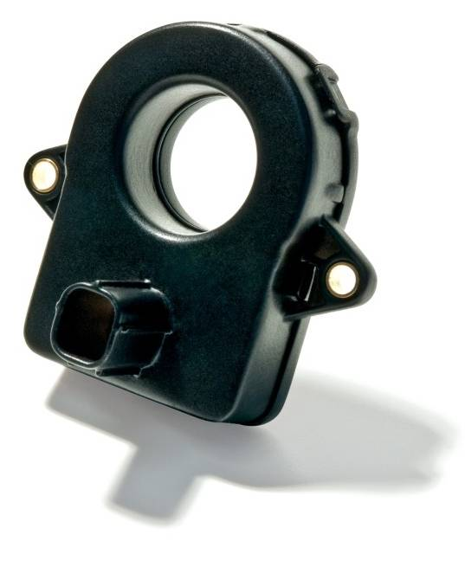
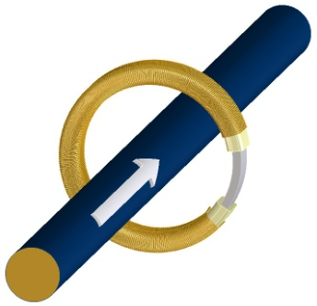
CAB300 Features
Features:
Fluxgate technology
Current range up to +/- 350A
Offset error lower than 10mA
Linearity error < 0.1%
Global error < 1% (over temperature)
Ambient temperature: -40°C… +105°C
Digital output (CAN)
Vehicle 12V battery supply
Sensor can provide either instantaneous or average value
Bandwidth < 500Hz
2 connector type available
Near-zero offset and accuracy on full current range gives strong advantage on hybrid market
CAB 300-C SP1
Tyco connector
CAB 300-C
Waterproof
sumitomo connector

Slide 3
Current transducer comparison table
Parameter | CAB300-C SP2 | DHAB S/18 | HAH1BV S/24
Offset error | +/-10 mA | +/- 0.3A | +/-1.5 A
Global error at 30A (XG) | 50 mA | +/- 1.05 A | +/-2.1 A
Global error at 300A (XG) | 1500 mA | +/- 15 A | 8 A
Output type | CAN | Voltage, dual range | Voltage
Relative price (compared with HAH1) | 4 | 2 | 1
At high current, error is mainly due to gain and linearity errors
At low current, error is mainly due to offset error
All accuracy data are give under -40/+85°C temperature range

Slide 4
Transducer error on SOC measurement
Discharge
Target: Need to know the state of charge (SOC) of the battery taking into account the charge and discharge phase
Over a cycle, charge and discharge areas are equal
I(A)
Time
Charge
A CT gain error will add a constant factor than multiplies the measurement
Over one cycle the areas measured will be equal (error is the same on positive or negative values)
SOC error
An CT offset error will add a constant value to the measurement
This can lead to error on SOC measurement because charge and discharge areas will not be equals
SOC error

Slide 5
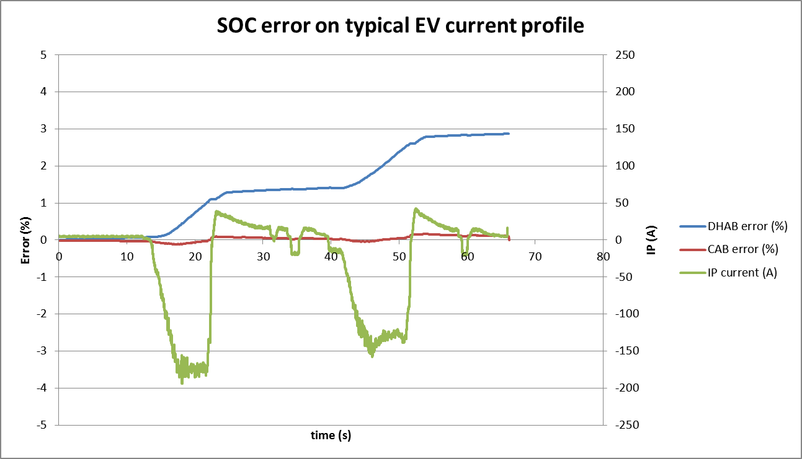
SOC error – Example on one current profile
SOC error: The bill
Battery pack price: 7000USD
Over-size of the battery to compensate SOC error:
7000x2.86% = 200 USD
Could worth to pay a little extra on the current transducer…
Reference sensor: - 513mA.h
DHAB 2 ranges: -528mA.h (2.86%)
CAB300: -514mA.h (0.1%)

